Slide 1
Running with Scissors
Notes:
https://en.wikipedia.org/wiki/Scissors#History
https://gizmodo.com/the-extraordinary-evolution-of-the-most-common-tool-sc-1617641302
https://idioms.thefreedictionary.com/run+with+scissors
https://healthandfitnesshistory.com/explore-history/history-of-running/
https://www.vampiretools.com/blog/now-something-completely-different-scissors-superstitions/

Slide 2
Running with Scissors
ADVANCED
Notes:
Welcome to Running with Scissors

Slide 3
Agenda
...You will build a cookbook in a test-driven approach with InSpec, extract the InSpec tests/controls into a InSpec profile, use the InSpec profile to test another cookbook, use the InSpec profile to scan non-nodes (agent-less), and finally use the InSpec profile with the Chef Audit cookbook to run on nodes (chef-client agent).

Slide 4
What is Advanced?
My definition of advanced does not mean you are required to understand a large body of concepts before coming into this workshop. So when I have made an assumption about
Advanced to me means that with a clear explanation you are able to reason well enough to mentally place this concept into the landscape of the other concepts necessary to complete the work.
In my experience, this often means you are already familiar with concepts and operations making the operation of understanding quicker.

Slide 5
You are...
interested in learning more about Chef, InSpec, and Habitat.
written Chef resources within a recipe in a cookbook

Slide 6
You are...
interested in learning more about Chef, InSpec, and Habitat.
written Chef resources within a recipe in a cookbook
tested a recipe with Test Kitchen

Slide 7
You are...
interested in learning more about Chef, InSpec, and Habitat.
written Chef resources within a recipe in a cookbook
tested a recipe with Test Kitchen
written a cookbook with a dependency on other cookbooks

Slide 8
You are...
interested in learning more about Chef, InSpec, and Habitat.
written Chef resources within a recipe in a cookbook
tested a recipe with Test Kitchen
written a cookbook with a dependency on other cookbooks

Slide 9
Lord Vader, the DEATH STAR is complete. We scienced the shit out of it!

Slide 10
Lord Vader, the DEATH STAR is complete. We scienced the shit out of it!
Did anyone write tests? I don't want any vulnerabilities!
Notes:
My name is Franklin Webber. I work on the Training Team at Chef. In that time I have delivered a number of classes in-person and online. I have delivered workshops at previous ChefConfs and Chef Community summits. I have also developed a lot of training materials for Learn Chef Rally.

Slide 11
Introduce Ourselves
Name
Where you work
The best part of your work and the most challenging part of your work
A favorite hobby or past time as a child
Why you came to ChefConf and what you want to get out of it
Notes:
Before we get started, I think it is important to take a moment to introduce ourselves to one another.
Instructor Note: Often times with larger, in-person groups I prefer to have the individuals perform this introduction one-on-one. Having people leave their seats and greet as many people as they can during the time allotted. I often feel this works better as it removes the pressure from the single individual to introduce themselves in a way that is presenting themselves and not actually greeting people. When Online, I create a pre-defined order, announce that order, and then invite a person to speak, thank them when they are done.

Slide 12





Slack - #running_with_scissors
Nick Rycar
Galen Emery
@nrycar
@galen
Damien O'Neal
Franklin Webber
@Damien
@burtlo
Notes:
The following individuals are also here to facilitate your learning today. They are all very capable Chef PR actioners that can help answering your questions, troubleshoot your code and engage in discussions with you.

Slide 13
Expectations
You will leave this workshop with the ability to:
identify the various concerns within a recipe/cookbook
develop InSpec tests for a service/application
create InSpec profiles that provide re-use in cookbook testing
setup the execution of InSpec profiles on every node converge
Ask Us Anything: It is important that we answer your questions and set each other on the path to be able to find more answers.
Notes:
All throughout this training I strongly encourage you to ask questions whenever you do not understand a topic, an acronym, concept, or software. By asking a question you better your learning and often times better the learning of those with you in this training. Asking questions is a sign of curiosity that we want to encourage and foster while we are here together.

Slide 14
Schedule
9:00 - 9:50 – Introductions and Code Review
10:00 - 10:50 – First Web Service
11:00 - 11:50 – Second Web Service
12:00 - 13:00 – LUNCH
Notes:
I have broken the day out in the following sections. Currently we are in the introduction section and we will finish this section with a code review exercise. We will then break for 10 minutes and then return and start work on our first challenge of testing and refactoring the first web service. We will repeat this activity for a second web service - reinforcing our skills and/or applying new techniques. Then we will break for lunch.

Slide 15
Schedule
12:00 - 13:00 – LUNCH
13:00 - 13:50 – Re-use with InSpec Profiles
14:00 - 14:50 – Third Web Service
15:00 - 15:50 – Audit Cookbook
16:00 - 16:30 – A Web Service in Habitat
16:30 - 16:50 – Summary / Wrap up
Notes:
After working with that second exercise you will begin to notice some patterns and repetition within your work. After lunch we will explore techniques to reduce this repetition. And then we will look at a third cookbook that will have you apply similar techniques and patterns again. After seeing these three examples its time for us to explore how these cookbook developments practices can aid us in validating the systems we provision and configure in our integration and production environments. Finally, we will take a moment to explore how the application cookbooks we have developed is a pattern that appears in the world of Habitat. Lastly, during our wrap-up I will take a moment to provide you resources to further reinforce the work you did today and expand your skills.

Slide 16
Agenda of a Challenge
Overview and Concepts (15 minutes)
Outline the challenge that you are about to face and define success criteria
Define the tools and techniques you are going to use to solve the problem
Exercise (25 minutes)
During this time you will solve the challenge with all of us supporting one another
Review (10 minutes)
Demonstration and review the techniques and answer questions
Notes:
During the workshop I want to give you as much autonomy as possible to explore the material presented. Learning in this manner can be challenging if you are expecting to be told exactly what code to write to solve the problems. I will start by introducing the challenge and then present the concepts that will assist you in overcoming this challenge. Then it will be your turn to complete the challenge applying these concepts in this specific scenario.
You are not alone. I encourage you to work together to solve these challenges together. Myself and the other facilitators are here to help you if you feel uncertain about what you are suppose to accomplish or how to accomplish it. Together we will get through these exercises.

Slide 17
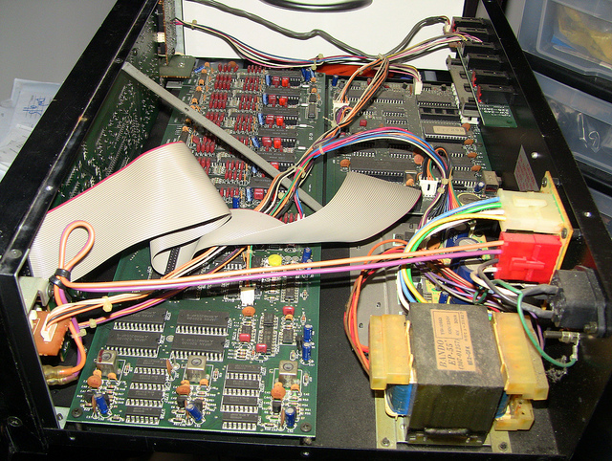
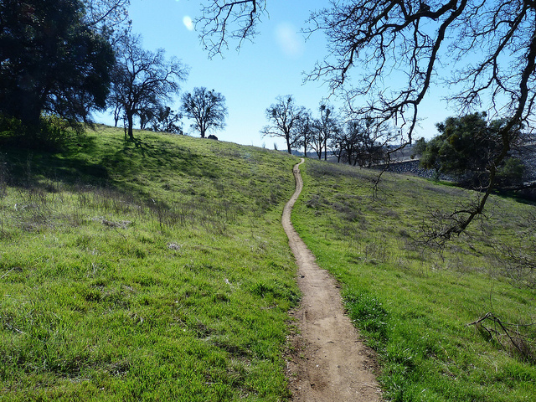

Extra Time?
BREAK
IT
ANOTHER PATH
HELP OTHERS
Notes:
Break It: If everything works the first time go back and make some changes. Explore! Discovering the boundaries will help you when you continue on your journey. This curiosity can also be employed by exploring the boundaries of the tools you are using and the language you are writing. The exercises and the labs we will perform will often lead you through examples that work from the beginning to the end. When you develop solutions it is rare that something works from the start all the way to the end. Errors and issues come up from typos or the incorrect usage of a command of the programming language. When you fall off the path it can often be hard to find your way back. Here, if you find yourself always on the correct path explore what happens when you step off of it, what you see, the error messages you are presented with, the new results you might find.
Take a Diversion: Several exercises here are open to many different paths. For clarity I will keep the exercises pretty bounded, if something catches your eye that is off the path -- take it.
Help Others: The best way to learn is to teach. This will help reinforce what it is you accomplished.
Break It: Pete Brown @ https://flic.kr/p/db4NyJ
Another Path: Vince @ https://flic.kr/p/9hfXFf
Help Others: Johnathon Nguyen @ https://flic.kr/p/8qnkP5

Slide 18
Remotely
Locally
Login to the a remote workstation:
user: chef
password: Cod3Can!
Workstations:
https://goo.gl/nmp2pV
System Requirements:
* Chef Development Kit (2.5.3)
* Docker (18.03.1-ce)
* kitchen-dokken (2.6.7)
Clone/download:
https://github.com/chef-training/running_with_scissors
Notes:
There are two ways to engage with the content. The preferred path for those of us here to support you is on a remote workstation. The link provided has each of your names listed and an instance available that you are able to connect to and use. It has all the tools and the content that was tested against it.

Slide 19
Challenge: Code Review
Notes:
Before we start logging into systems and working with code you are going to perform an exercise where we view the code away from the context of it being executed. The concepts we explore during this exercise will appear again and again in all three of the web service cookbooks you use today and likely your time working with Chef and InSpec.

Slide 20
Challenge: Code Review
Overview
Concepts
Exercise
Review
Notes:
Code review is an examination of source code. It is a useful process that helps us ensure the code we write is correct and increases its quality.

Slide 21
Ruby Service
This web service is built in Ruby. It provides an interface that enables:
Create new scans
Read all scans or a scan
Update any existing scans
Delete any existing scans
POST http://localhost:8000/scans
GET http://localhost:8000/scans
PUT http://localhost:8000/scan/{id}
DELETE http://localhost:8000/scan/{id}
Notes:
The first cookbook has a single default recipe which setups a web service. This web service enables you to upload JSON data to it. This data are the scan results that are generated from InSpec (though it could be any data). This is a rudimentary implementation and if you were to interact with the service itself you would find a very crude interface. It is essentially a rudimentary reporting service.

Slide 22
Viewing the Contents of the ruby_service
> tree cookbooks/ruby_service
cookbooks/ruby_service
├── files
│ └── specter.zip
├── recipes
│ └── default.rb
├── templates
│ ├── service.erb
│ ├── start.sh.erb
│ └── stop.sh.erb
│

Slide 23
First Service's Default Recipe
~/cookbooks/ruby_service/recipes/default.rb
directory '/srv'
package 'unzip'
cookbook_file '/srv/specter.zip' do
source 'specter.zip'
notifies :run, 'execute[extract_site]', :immediately
end
execute 'extract_site' do
cwd '/srv'
command 'unzip specter.zip'
not_if { File.exist?('/srv/specter') }
action :nothing
end

Slide 24
First Service's Default Recipe
~/cookbooks/ruby_service/recipes/default.rb
package %w[git-core zlib zlib-devel gcc-c++ patch readline readline-devel libyaml-devel libffi-devel openssl-devel make bzip2 autoconf automake libtool bison curl sqlite-devel]
remote_file '/tmp/ruby-2.5.1.tar.gz' do
source 'https://cache.ruby-lang.org/pub/ruby/2.5/ruby-2.5.1.tar.gz'
end
execute 'extract ruby' do
cwd '/tmp'
command 'tar -xvf ruby-2.5.1.tar.gz'
not_if { File.exist?('/tmp/ruby-2.5.1') }
end

Slide 25
First Service's Default Recipe
~/cookbooks/ruby_service/recipes/default.rb
execute 'configure, make and install ruby' do
cwd '/tmp/ruby-2.5.1'
command './configure && make && make install'
not_if { File.exist?('/usr/local/bin/ruby') }
end
execute 'install bundler' do
command '/usr/local/bin/gem install bundler'
not_if { File.exist?('/usr/local/bin/bundle') }
end

Slide 26
First Service's Default Recipe
~/cookbooks/ruby_service/recipes/default.rb
execute 'bundle install' do
cwd '/srv/specter'
command '/usr/local/bin/bundle install'
not_if { File.exist?('/srv/specter/Gemfile.lock') }
end
execute 'database migration' do
cwd '/srv/specter'
command 'rake migrate'
end

Slide 27
First Service's Default Recipe
~/cookbooks/ruby_service/recipes/default.rb
template '/etc/systemd/system/specter.service' do
source 'service.erb'
variables({ service_name: 'specter', working_directory: '/srv/specter' })
end
template '/srv/specter/start.sh' do
source 'start.sh.erb'
mode '0774'
end
template '/srv/specter/stop.sh' do
source 'stop.sh.erb'
mode '0774'
end
service 'specter' do
action :start
end

Slide 28
Objective
Read through the source code and identify:
What is this recipe doing?
What values are being repeated?
How re-usable is this recipe?
What would you test in this recipe?

Slide 29
Challenge: Code Review
Overview
Concepts
Exercise
Review

Slide 30
Chef Resources

Slide 31
Notifications

Slide 32
Guards

Slide 33
Don't Repeat Yourself (DRY)
The DRY principle is stated as "Every piece of knowledge must have a single, unambiguous, authoritative representation within a system"
~Wikipedia

Slide 34
Repetition within a Recipe
directory '/srv'
cookbook_file '/srv/specter.zip' do
source 'specter.zip'
notifies :run, 'execute[extract_site]', :immediately
end
execute 'extract_site' do
cwd '/srv'
command 'unzip specter.zip'
not_if { File.exist?('/srv/specter') }
action :nothing
end
What concepts are being expressed as parameters?
How many representations of a concept exist?
Would a change to one of these parameters still allow the system to function as it originally intended?

Slide 35
Separation of Concerns
"... is a design principle for separating a computer program into distinct sections, such that each section addresses a separate concern."
~ Wikipedia

Slide 36
Single Responsibility Principle
"...every module should have responsibility over a single part of the functionality provided by the software, and that responsibility should be entirely encapsulated by the module. Robert C. Martin expresses the principle as, "A class should have only one reason to change.""
~ Wikipedia

Slide 37
Concerns of a Cookbook
ruby_service
What would be the comment you write above a resource or group of resources to describe its purpose?
default
install
configuration
service

Slide 38
Reusability
Code reuse, also called software reuse, is the use of existing software, or software knowledge, to build new software.
~ Wikipedia

Slide 39
Reusability with Cookbooks
ruby_service
another_ruby_service
default
default
install
configuration
configuration
service

Slide 40
Testing
Software testing involves the execution of a software component or system component to evaluate one or more properties of interest. In general, these properties indicate the extent to which the component or system under test meets the requirements that guided its design and development.
~ Wikipedia

Slide 41
Testing the Recipe's Concern
ruby_service
What is module's concern?
Does the module perform the operation it was intended to perform?
default
install
configuration
service

Slide 42
Challenge: Code Review
Overview
Concepts
Exercise
Review

Slide 43
Enter the Project Directory
> cd ~/cookbooks/ruby_service
Notes:
Because the next section we are going to write tests and possibly refactor this cookbook this is a good time to prepare our test environment.
Change into the service's directory.

Slide 44
Converge a Test System
> kitchen converge
-----> Starting Kitchen (v1.20.0)
-----> Creating <default-centos-7>...
Creating kitchen sandbox at /home/chef/.dok...ault-centos-7
Creating verifier sandbox at /home/chef/.do...ault-centos-7
Building work image..
Creating container 06915d9eff-default-centos-7
Finished creating <default-centos-7> (0m42.81s).
-----> Converging <default-centos-7>...
Creating kitchen sandbox in /home/chef/.dok...
...
Notes:
Run this command to prepare our test system.

Slide 45
Code Review
What is this recipe doing?
What values are being repeated?
What is re-usable is this recipe?
What would you test in this recipe?
Form an opinion about what is happening, what you would test, and how you would improve the quality of this code.
Notes:
Using the printed hand out, review the code and answer the following questions. Feel free to have this discussion with the individuals around you that you met during the introduction. This will help you share your views and have a moment to listen to another person's perspective.
Success is defined as you having an opinion about what is happening, what you would test, and how you would improve this recipe.

Slide 46
Challenge: Code Review
Overview
Concepts
Exercise
Review

Slide 47
Discussion
How re-usable is this recipe?
What would you test in this recipe?

Slide 48
Challenge: Code Review
Overview
Concepts
Exercise
Review

Slide 49
Discussion
What questions can we answer for you?

Slide 50

Take a Break
Notes:
play4smee @ https://flic.kr/p/6gEPqQ

Slide 51
Challenge: First Web Service
Overview
Concepts
Exercise
Review

Slide 52
Ruby Service
This web service is built in Ruby. It provides an interface that enables:
Create new scans
Read all scans or a scan
Update any existing scans
Delete any existing scans
POST http://localhost:8000/scans
GET http://localhost:8000/scans
PUT http://localhost:8000/scan/{id}
DELETE http://localhost:8000/scan/{id}
Notes:
The first cookbook has a single default recipe which setups a web service. This web service enables you to upload JSON data to it. This data are the scan results that are generated from InSpec (though it could be any data). This is a rudimentary implementation and if you were to interact with the service itself you would find a very crude interface. It is essentially a rudimentary reporting service.

Slide 53
Ruby Implementation
Requirement | File
Ruby 2.5.1 | /usr/local/bin/ruby
Bundler | /usr/local/bin/bundler
Rackup | /usr/local/bin/rackup
Systemd | /usr/bin/systemctl
Notes:
This web service is expressed in Ruby. For the web service to execute the following resources need to be present on the system.

Slide 54
Objective
Describe the expected behavior with InSpec tests and verify that the web service meets those expectations.

Slide 55
Challenge: First Web Service
Overview
Concepts
Exercise
Review

Slide 56
Testing and Refactoring
Where do you write your tests?
What tests do you write?
How do you execute tests?
How could the code be refactored?

Slide 57
Test Kitchen's Configuration
When chef generates a cookbook a default .kitchen.yml is created.
http://kitchen.ci/docs/getting-started/kitchen-yml
The configuration is stored in a file format called YAML (http://yaml.org).

Slide 58
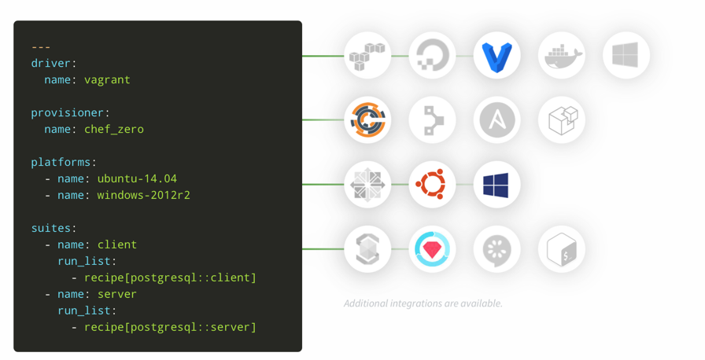

Test Kitchen's Configuration Makes it Versatile
kitchen.ci

Slide 59
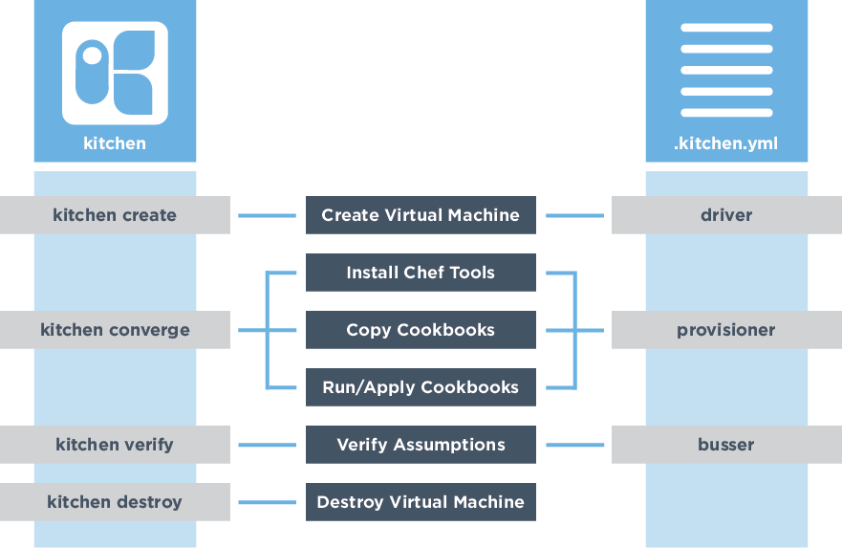
Test Kitchen's Configuration
Create Test Instance
Install Chef
Synchronize Cookbooks
Apply the Run List
Execute Tests
Destroy Instance

Slide 60
Driver, Provisioner, and Transport
~/cookbooks/ruby_service/.kitchen.yml
driver:
name: dokken
provisioner:
name: dokken
transport:
name: dokken
verifier:
name: inspec
Notes:
Reference: https://blog.chef.io/2018/03/06/kitchen-docker-or-kitchen-dokken-using-test-kitchen-and-docker-for-fast-cookbook-testing/
Kitchen-Dokken by Awesome Community Chef Sean O’Meara is optimized for speed and testing Chef recipes. It achieves this goal by using pre-built Docker images and using bind mounts to share data like the Chef Client itself and the cookbooks without the need to copy it into the container. This can result in significant speed improvements with no additional configuration burden. It blurs the lines between driver, provisioner, and transport and as such diverges from more “traditional” drivers. Currently it is specific to Chef use cases and is part of the ChefDK. It uses systemd as the PID 1 inside the container to allow for testing of resources like service.

Slide 61
Kitchen Platforms and Test Suites
~/cookbooks/ruby_service/.kitchen.yml
platforms:
- name: centos-7
driver:
image: dokken/centos-7
privileged: true
pid_one_command: /usr/lib/systemd/systemd
volumes:
- /sys/fs/cgroup:/sys/fs/cgroup:ro # required by systemd
suites:
- name: default
run_list:
- recipe[ruby_service::default]
verifier:
inspec_tests:
- test/integration/default
attributes:

Slide 62
The Test Matrix
Kitchen defines a list of instances, or test matrix, based on the platforms multiplied by the suites.
PLATFORMS x SUITES
> kitchen list
Instance Driver Provisioner Verifier Transport Last Action ...
default-centos-7 Dokken Dokken Inspec Dokken Converged ...

Slide 63
Default Suite Test File
~/cookbooks/ruby_service/test/integration/default/default_test.rb
# encoding: utf-8
# REFERENCE
# https://inspec.io/docs/reference/resources/command
# https://inspec.io/docs/reference/resources/host
# https://inspec.io/docs/reference/resources/port
# https://inspec.io/docs/reference/resources/service

Slide 64
Testing and Refactoring
Where do you write your tests?
What tests do you write?
How do you execute tests?
How could the code be refactored?

Slide 65
InSpec Resources
InSpec has 80+ resources ready use and if you need a solution that we haven’t provided, you can write your own custom resource.
file
command
host
port
http
service
Notes:
Reference: https://www.inspec.io/docs/reference/resources

Slide 66
InSpec: file
Use the file InSpec audit resource to test all system file types, including files, directories ...
describe file('/usr/local/bin/ruby') do
it { should exist }
it { should be_executable }
end
describe file('/srv/specter') do
it { should be_directory }
its('owner') { should eq 'root' }
end
Notes:
Reference: https://www.inspec.io/docs/reference/resources/file/

Slide 67
InSpec: command
Use the command InSpec audit resource to test an arbitrary command that is run on the system.
describe command('/usr/local/bin/ruby') do
it { should exist }
end
describe command('/usr/local/bin/ruby -v') do
its('stdout') { should match('2.5.1') }
end
Notes:
Reference: https://www.inspec.io/docs/reference/resources/command/

Slide 68
InSpec: command
Use the command InSpec audit resource to test an arbitrary command that is run on the system.
describe command('curl http://localhost:8000') do
its('stdout') { should match('welcome friend') }
end
Notes:
command: https://www.inspec.io/docs/reference/resources/command/

Slide 69
InSpec: host
Use the host InSpec audit resource to test the name used to refer to a specific host and its availability, including the Internet protocols and ports over which that host name should be available.
describe host('localhost', port: 8000, protocol: 'tcp') do
it { should be_reachable }
it { should be_resolvable }
end
Notes:
Reference: https://www.inspec.io/docs/reference/resources/host/

Slide 70
InSpec: port
Use the port InSpec audit resource to test basic port properties, such as port, process, if it’s listening.
describe port(8000) do
it { should be_listening }
its('processes') {should include 'ruby'}
end
Notes:
Reference: https://www.inspec.io/docs/reference/resources/port/

Slide 71
InSpec: http
Use the http InSpec audit resource to test an http endpoint.
describe http('http://localhost:8000', enable_remote_worker: true) do
its('status') { should eq 200 }
end
Notes:
Reference: https://www.inspec.io/docs/reference/resources/http/
Beginning with InSpec 1.41, you can enable the ability to have the HTTP test execute on the remote target with 'enable_remote_worker'. In InSpec 2.0, the HTTP test will automatically execute remotely whenever InSpec is testing a remote node.

Slide 72
InSpec: service
Use the service InSpec audit resource to test if the named service is installed, running and/or enabled.
describe service('ruby_service') do
it { should be_installed }
it { should be_running }
end
Notes:
Reference: https://www.inspec.io/docs/reference/resources/service/

Slide 73
Execute the Tests
> kitchen verify
-----> Starting Kitchen (v1.20.0)
-----> Verifying <default-centos-7>...
Loaded tests from {:path=>".Users.franklinwebber.running_with_scissors.ruby_service.test.integration.default"}
Profile: tests from {:path=>"/Users/franklinwebber/running_with_scissors/ruby_service/test/integration/default"} (tests from {:path=>".Users.franklinwebber.running_with_scissors.ruby_service.test.integration.default"})
Version: (not specified)

Slide 74
Testing and Refactoring
Where do you write your tests?
What tests do you write?
How do you execute tests?
How could the code be refactored?

Slide 75
Test Kitchen's Commands
Create Test Instance
Install Chef
Synchronize Cookbooks
Apply the Run List
Execute Tests
Destroy Instance

Slide 76
Kitchen Verify
> kitchen verify [INSTANCE|REGEXP|all]
Create, converge, and verify one or more test instances.
Synchronize Cookbooks
Create Test Instance
Install Chef
Execute Tests
Apply the Run List

Slide 77
Testing and Refactoring
Where do you write your tests?
What tests do you write?
How do you execute tests?
How could the code be refactored?

Slide 78
Refactoring
Code refactoring is the process of restructuring existing computer code—changing the factoring—without changing its external behavior.
~ Wikipedia
Define a test set for the unit first
Then implement the unit
Finally verify that the implementation of the unit makes the tests succeed.
Refactor

Slide 79
Ruby: Variables
A variable whose name begins with a lowercase letter (a-z) or underscore (_) is a local variable or method invocation.
site_path = '/srv/specter'
execute 'extract_site' do
cwd '/srv'
command 'unzip specter.zip'
not_if { File.exist?(site_path) }
action :nothing
end

Slide 80
Chef: Attributes
An attribute is a specific detail about a node. Cookbooks may appended additional details.
Creating an attributes file within a cookbook:
> chef generate attribute default
Notes:
Reference: https://docs.chef.io/attributes.html

Slide 81
Chef: Define an Attribute
The attribute is defined at particular precedence level in the attributes file and then it is retrieved from the node object.
~/cookbooks/ruby_service/attributes/default.rb
default['ruby_service']['site_path'] = '/srv/specter'
Notes:
Reference: https://docs.chef.io/attributes.html

Slide 82
Chef: Use an Attribute
The attribute is defined on the node object and may be retrieved in the recipe.
~/cookbooks/ruby_service/recipe/default.rb
site_path = node['ruby_service']['site_path']
execute 'extract_site' do
cwd '/srv'
command 'unzip specter.zip'
not_if { File.exist?(site_path) }
action :nothing
end
Notes:
Reference: https://docs.chef.io/attributes.html

Slide 83
Chef: include_recipe
A recipe can include one (or more) recipes located in cookbooks by using the include_recipe method. When a recipe is included, the resources found in that recipe will be inserted (in the same exact order) at the point where the include_recipe keyword is located.
https://docs.chef.io/dsl_recipe.html#include-recipes

Slide 84
Chef: include_recipe
recipes/default.rb
default.rb
include_recipe 'cookbook::install'
include_recipe 'cookbook::configuration'
include_recipe 'cookbook::service'
install.rb
configuration.rb
service.rb
Notes:
Reference: https://docs.chef.io/dsl_recipe.html#include-recipes

Slide 85
Create a Recipe
The Chef DK provides another convenience command to assist you with creating recipes. It generates the recipe file and associated test files.
> chef generate recipe install
> rm test/integration/default/install_test.rb

Slide 86
Chef: Custom Resource
A custom resource is an extension of Chef that adds your own resources and is implemented and shipped as part of a cookbook.
~/cookbooks/ruby_service/recipes/default.rb
ruby_service_site 'specter' do
source 'specter.zip'
path '/srv'
action :create
end

Slide 87
Create a Custom Resource
The Chef DK provides another convenience command to assist you with creating custom resources
> chef generate resource site

Slide 88
Custom Resource
The properties have a type and specify if they required. One property may be associated with the name value.
~/cookbooks/ruby_service/resources/site.rb
property :site_name, String, name_property: true
property :source, String, required: true
property :path, String, required: true
action :create do
# ...
end

Slide 89
Custom Resource Action with Properties
~/cookbooks/ruby_service/resources/site.rb
action :create do
# ... other resources ...
site_path = "#{new_resource.path}/#{new_resource.site_name}"
execute 'extract_site' do
cwd new_resource.path
command 'unzip specter.zip'
not_if { File.exist?(site_path) }
action :nothing
end
end

Slide 90
Testing and Refactoring
Where do you write your tests?
What tests do you write?
How do you execute tests?
How could the code be refactored?

Slide 91
Challenge: First Web Service
Overview
Concepts
Exercise
Review

Slide 92
First Web Service
Converge the cookbook
Write tests for the cookbook
Execute the tests
Assist, Break it, Explore or Refactor
Write at least one test that give you the confidence that the site is working.

Slide 93
Challenge: First Web Service
Overview
Concepts
Exercise
Review

Slide 94
Live Demonstration

Slide 95
Challenge: First Web Service
Overview
Concepts
Exercise
Review

Slide 96
Take a Break
Notes:
play4smee @ https://flic.kr/p/6gEPqQ

Slide 97
Challenge: Second Web Service
Overview
Concepts
Exercise
Review

Slide 98
Node Service
This web service is built in JavaScript. It provides the same interface
Create new scans
Read all scans or a scan
Update any existing scans
Delete any existing scans
POST http://localhost:8000/scans
GET http://localhost:8000/scans
PUT http://localhost:8000/scan/{id}
DELETE http://localhost:8000/scan/{id}
Notes:
The second cookbook has a single default recipe which setups a web service. This web service enables you to upload JSON data to it. This data are the scan results that are generated from InSpec (though it could be any data). This is a rudimentary implementation and if you were to interact with the service itself you would find a very crude interface. It is essentially a rudimentary reporting service.

Slide 99
Node Implementation
Requirement | File
Node 10.1.0 | /usr/local/bin/node
npm | /usr/local/bin/npm
Systemd | /usr/bin/systemctl
Notes:
This web service is expressed in Node. For the web service to execute the following resources need to be present on the system.

Slide 100
Objective
Describe the expected behavior with InSpec tests and verify that the web service meets those expectations.

Slide 101
Challenge: Second Web Service
Overview
Concepts
Exercise
Review

Slide 102
Testing and Refactoring
Where do you write your tests?
What tests do you write?
InSpec: file; command; host; port; and service.
How do you execute tests?
~/cookbooks/node_service/test/integration/default/default_test.rb
> kitchen verify [INSTANCE|REGEXP|all]

Slide 103
Logging in the Test Instance
> kitchen login [INSTANCE|REGEXP]
Create a terminal session inside of the container.

Slide 104
InSpec: json
Use the json InSpec audit resource to test data in a JSON file.
describe json({ command: 'curl localhost:8000/scans' }) do
it { should_not be_empty }
its('count') { should eq 1 }
end
Notes:
Reference: https://www.inspec.io/docs/reference/resources/json/

Slide 105
Testing and Refactoring
How could the code be refactored?
Ruby variables
Node attributes
include_recipe
Custom resource

Slide 106
Challenge: Second Web Service
Overview
Concepts
Exercise
Review

Slide 107
Second Web Service
Converge the cookbook
Write tests for the cookbook
Execute the tests
Assist, Break it, Explore or Refactor
Write at least one test that give you the confidence that the site is working.

Slide 108
Challenge: Second Web Service
Overview
Concepts
Exercise
Review

Slide 109
Live Demonstration

Slide 110
Challenge: Second Web Service
Overview
Concepts
Exercise
Review

Slide 111
Take a Break
Notes:
play4smee @ https://flic.kr/p/6gEPqQ

Slide 112
Challenge: Re-use with InSpec Profiles
Overview
Concepts
Exercise
Review

Slide 113
Test Duplication
Both of these web services share a common interface even if the implementation differs. Creating a shared set of tests for the service would enable you to test both services and immediately handle any future implementations..

Slide 114
Objective
Reduce duplication of tests across these cookbooks by collecting the InSpec tests/controls into a single artifact called an InSpec profile.

Slide 115
Challenge: Re-use with InSpec Profiles
Overview
Concepts
Exercise
Review

Slide 116
Refactoring Tests
Initializing an InSpec profile
Using an InSpec profiles with Test Kitchen
Managing platform specific tests

Slide 117
Initialize an InSpec Profile
InSpec controls can be defined in their own artifact. This enables them to be reused across cookbook test suites and used to scan your target infrastructure.
> cd ~
> mkdir profiles
> cd profiles
> inspec init profile webservice-baseline

Slide 118
Anatomy of an InSpec Profile
InSpec profiles, like cookbooks have consistent file structure.
> tree webservice-baseline
webservice-baseline
├── README.md
├── controls
│ └── example.rb
├── inspec.yml
└── libraries

Slide 119
Refactoring Tests
Initializing an InSpec profile
Using an InSpec profiles with Test Kitchen
Managing platform specific tests

Slide 120
Adding a new Test Location
~/cookbooks/ruby_service/.kitchen.yml
# ... PLATFORMS ... #
suites:
- name: default
run_list:
- recipe[ruby_service::default]
verifier:
inspec_tests:
- test/integration/default
- ../../profiles/webservice-baseline
attributes:

Slide 121
Adding Tests/Controls to the Profile
~/profiles/webservice-baseline/controls/default.rb
describe host('localhost', port: 8000, protocol: 'tcp') do
it { should be_reachable }
it { should be_resolvable }
end
describe port(8000) do
it { should be_listening }
its('processes') { should include 'ruby'}
end

Slide 122
Platform Specific Tests
~/profiles/webservice-baseline/controls/default.rb
describe host('localhost', port: 8000, protocol: 'tcp') do
it { should be_reachable }
it { should be_resolvable }
end
describe port(8000) do
it { should be_listening }
its('processes') { should include 'ruby'}
end

Slide 123
Refactoring Tests
Initializing an InSpec profile
Using an InSpec profiles with Test Kitchen
Managing platform specific tests

Slide 124
Leave them in the Cookbook
These implementation specific tests are useful but they could remain in the cookbook's test files.
... ration/default/test_default.rb
...controls/default.rb
describe port(8000) do
its('processes') { should include 'ruby'}
end
describe port(8000) do
it { should be_listening }
end

Slide 125
Refactoring Tests
Initializing an InSpec profile
Using an InSpec profiles with Test Kitchen
Managing platform specific tests

Slide 126
Challenge: Re-use with InSpec Profiles
Overview
Concepts
Exercise
Review

Slide 127
Re-use with InSpec Profiles
Initialize an InSpec profile
Populate the InSpec profile with platform agnostic controls
Both web service cookbooks are verified by an InSpec profile

Slide 128
Challenge: Re-use with InSpec Profiles
Overview
Concepts
Exercise
Review

Slide 129
Live Demonstration

Slide 130
Challenge: Re-use with InSpec Profiles
Overview
Concepts
Exercise
Review

Slide 131
Take a Break
Notes:
play4smee @ https://flic.kr/p/6gEPqQ

Slide 132
Challenge: Third Web Service
Overview
Concepts
Exercise
Review

Slide 133
Rust Service
This web service is built in Rust. It provides the same interface
Create new scans
Read all scans or a scan
Update any existing scans
Delete any existing scans
POST http://localhost:8000/scans
GET http://localhost:8000/scans
PUT http://localhost:8000/scan/{id}
DELETE http://localhost:8000/scan/{id}
Notes:
The third cookbook has a single default recipe which setups a web service. This web service enables you to upload JSON data to it. This data are the scan results that are generated from InSpec (though it could be any data). This is a rudimentary implementation and if you were to interact with the service itself you would find a very crude interface. It is essentially a rudimentary reporting service.

Slide 134
Rust Implementation
Requirement | File
Rust | /root/.cargo/bin/rustc
cargo | /root/.cargo/bin/cargo
diesel-cli | /root/.cargo/bin/diesel
Systemd | /usr/bin/systemctl
Notes:
This web service is expressed in Node. For the web service to execute the following resources need to be present on the system.

Slide 135
Objective
Describe the expected behavior with existing InSpec tests and new platform specific tests and verify that the web service meets those expectations.

Slide 136
Challenge: Third Web Service
Overview
Concepts
Exercise
Review

Slide 137
Testing and Refactoring
Where do you write your tests?
What tests do you write?
InSpec: file; command; host; port; service; and json.
How do you execute tests?
~/cookbooks/rust_service/test/integration/default/default_test.rb
> kitchen verify [INSTANCE|REGEXP|all]

Slide 138
Logging in the Test Instance
> kitchen login [INSTANCE|REGEXP]
Create a terminal session inside of the container.

Slide 139
Testing and Refactoring
How could the code be refactored?
Ruby variables
Node attributes
include_recipe
Custom resource

Slide 140
Leave them in the Cookbook
These implementation specific tests are useful but they could remain in the cookbook's test files.
... ration/default/test_default.rb
...controls/default.rb
describe port(8000) do
its('processes') { should include 'rust'}
end
describe port(8000) do
it { should be_listening }
end

Slide 141
Conditional Execution of Control Files
...controls/rust.rb
...controls/default.rb
only_if do
command('/root/.cargo/bin/cargo').exist?
end
describe port(8000) do
its('processes') { should include 'rust'}
end
describe port(8000) do
it { should be_listening }
end

Slide 142
Conditional Execution of Controls
~/profiles/webservice-default/controls/default.rb
control 'svc-rust-01' do
only_if do
command('/root/.cargo/bin/cargo').exist?
end
describe port(8000) do
its('processes') { should include 'rust'}
end
end
control 'svc-01' do
describe port(8000) do
its('processes') { should include 'rust'}
end
end

Slide 143
Challenge: Third Web Service
Overview
Concepts
Exercise
Review

Slide 144
Third Web Service
Converge the cookbook
Write tests in the cookbook or in the profile with conditions
Execute the tests
Assist, Break it, Explore or Refactor
Write at least one test that give you the confidence that the site is working.

Slide 145
Challenge: Third Web Service
Overview
Concepts
Exercise
Review

Slide 146
Live Demonstration

Slide 147
Challenge: Third Web Service
Overview
Concepts
Exercise
Review

Slide 148
Take a Break
Notes:
play4smee @ https://flic.kr/p/6gEPqQ

Slide 149
Challenge: Audit Cookbook
Overview
Concepts
Exercise
Review

Slide 150
Testing Outside of Development
The tests that you wrote can also be used to verify the state of your systems in production using the same InSpec profile.

Slide 151
Objective
Execute a scan automatically after a test instance converges the service recipe.

Slide 152
Challenge: Audit Cookbook
Overview
Concepts
Exercise
Review

Slide 153
Testing after Converge
Archive the profile
Wrap the Audit cookbook
Execute a scan in a post converge event with Chef.event_handler
Setup a new test suite to execute this scan

Slide 154
Archive an InSpec Profile
> inspec archive PATH
Inspec profiles can be archived for easy transport.

Slide 155
Store the Profile in the Cookbook
> cp profiles/webservice-baseline-0.1.0.tar.gz
cookbooks/azrael/files/profiles/
Storing the profile as an archive in the cookbook is not ideal as it would require us to release new versions of the cookbook as we update the profile. Alternatives are to use a url or git.

Slide 156
Testing after Converge
Archive the profile
Wrap the Audit cookbook
Execute a scan in a post converge event with Chef.event_handler
Setup a new test suite to execute this scan

Slide 157
Wrapper Cookbook Pattern
When you want to use a cookbook for its recipes but modify the attributes it is often called wrapping that cookbook.
Add a dependency in the wrapper cookbook's metadata
Override the attributes
Use include_recipe in the wrapper cookbook to load the original

Slide 158
Attribute Precedence
Notes:
Reference: https://docs.chef.io/attributes.html

Slide 159
Attribute Precedence
Notes:
Reference: https://docs.chef.io/attributes.html

Slide 160
Overriding the Default Attributes
~/cookbooks/azrael/recipes/deafult.rb
node.default['audit'] = {
'reporter' => 'json-file',
'interval' => { 'enabled' => false },
'profiles' => [
# TODO: archive the profile and stored in the cookbook
{
'name' => 'webservice-baseline',
'path' => "#{Chef::Config[:cookbook_path]}/#{cookbook_name}/files/profiles/webservice-baseline-0.1.0.tar.gz"
}
]
}
Notes:
Reference: https://github.com/chef-cookbooks/audit

Slide 161
Testing after Converge
Archive the profile
Wrap the Audit cookbook
Execute a scan in a post converge event with Chef.event_handler
Setup a new test suite to execute this scan

Slide 162
Chef.event_handler (12.5)
Use the Handler DSL to attach a callback to an event. If the event occurs during the chef-client run, the associated callback is executed.
There are a large number of events that can be acted upon.
Notes:
Reference: https://docs.chef.io/dsl_handler.html

Slide 163
Chef.event_handler with BASH
~/cookbooks/azrael/recipes/default.rb
Chef.event_handler do
on :run_completed do
scan_path = "#{Chef::Config[:cookbook_path]}/audit/inspec-*.json"
headers = '"Content-Type: application/json"'
url = 'http://localhost:8000/scans'
puts `curl -d @$(ls #{scan_path}) -H #{headers} #{url}`
end
end

Slide 164
Chef.event_handler with shell_out
~/cookbooks/azrael/recipes/default.rb
Chef.event_handler do
on :run_completed do
scan_path = "#{Chef::Config[:cookbook_path]}/audit/inspec-*.json"
headers = '"Content-Type: application/json"'
url = 'http://localhost:8000/scans'
upload = Mixlib::ShellOut.new "curl -d @$(ls #{scan_path}) -H #{headers} #{url}"
upload.run_command
end
end

Slide 165
Chef.event_handler with Ruby/Chef
~/cookbooks/azrael/recipes/default.rb
Chef.event_handler do
on :run_completed do
scan_path = "#{Chef::Config[:cookbook_path]}/audit/inspec-*.json"
connection = Chef::HTTP.new('http://localhost:8000')
headers = { 'Content-Type' => 'application/json' }
Dir[scan_path].each do |scan_file|
data = File.read(scan_file)
connection.post("/scans", data.to_s, headers)
end
end
end

Slide 166
Alternative: chef_handler resource
This resource is available in the chef_handler community cookbook (< 14.0)
This resource is now automatically present in chef-client 14.0.
Notes:
Reference: https://docs.chef.io/resource_chef_handler.html

Slide 167
Testing after Converge
Archive the profile
Wrap the Audit cookbook
Execute a scan in a post converge event with Chef.event_handler
Setup a new test suite to execute this scan

Slide 168
Metadata or Berksfile
Dependencies defined in the metadata will automatically be retrieved during a chef-client run whenever the cookbook is used.
Dependencies defined in the Berksfile will be loaded locally when performing testing. They will also be uploaded if you send cookbooks up to the Chef Server via Berkshelf.

Slide 169
Adding to the cookbook's Berksfile
~/cookbooks/node_service/Berksfile
# frozen_string_literal: true
source 'https://supermarket.chef.io'
metadata
cookbook 'azrael', path '../azrael'

Slide 170
Adding a new test suite
~/cookbooks/node_service/.kitchen.yml
suites:
- name: default
run_list:
- recipe[node_service::default]
verifier:
inspec_tests:
- test/integration/default
- ../../webservice-baseline
attributes:
- name: audit
run_list:
- recipe[node_service::default]
- recipe[azrael::default]
verifier:
inspec_tests:
- test/integration/audit
attributes:

Slide 171
Create the new audit suite test directory
> mkdir ~/cookbooks/node_service/test/integration/audit

Slide 172
Test that the Scan Count Increases
cookbooks/COOKBOOK/test/integration/scan/default_test.rb
# encoding: utf-8
describe json(command: 'curl http://localhost:8000/scans') do
its('count') { should > 1 }
end

Slide 173
Verifying a specific suite
> kitchen verify audit
Create, converge, and verify for one more more instances that match the name 'audit'

Slide 174
Testing after Converge
Archive the profile
Wrap the Audit cookbook
Execute a scan in a post converge event with Chef.event_handler
Setup a new test suite to execute this scan

Slide 175
Challenge: Audit Cookbook
Overview
Concepts
Exercise
Review

Slide 176
Audit Cookbook
Archive the profile and copy it into the azrael cookbook
Define the attributes within the wrapper recipe
Use Chef.event_handler
Add a dependency on the azrael cookbook in the Berksfile
Add a new Test Kitchen suite that installs the service and scans
Test that the scan completed and uploaded
Each cookbook has a scan test suite that performs performs an automatic scan when the converge finishes.

Slide 177
Challenge: Audit Cookbook
Overview
Concepts
Exercise
Review

Slide 178
Live Demonstration

Slide 179
Challenge: Audit Cookbook
Overview
Concepts
Exercise
Review

Slide 180
Take a Break
Notes:
play4smee @ https://flic.kr/p/6gEPqQ

Slide 181
Challenge: A Web Service in Habitat
Overview
Concepts
Exercise
Review

Slide 182
Patterns
In all of the web services we identified a pattern:
* Install the framework
* Copy the source
* Install dependencies
* Migrate the database
* Create / Start a service

Slide 183
Challenge: A Web Service in Habitat
Overview
Concepts
Exercise
Review

Slide 184
Generate a habitat plan
Habitat scaffolding
Habitat Studio
Build, Run, Export
InSpec Profiles testing Habitat

Slide 185
Challenge: A Web Service in Habitat
Overview
Concepts
Exercise
Review

Slide 186
A Web Service in Habitat
Generate a habitat plan and modify it as necessary
Enter the Habitat studio, build, run and export
Generate a Habitat artifact for the Service
Run the service artifact and the profile artifact
The Habitat supervisor is running the service artifact and profile artifact.

Slide 187
Challenge: A Web Service in Habitat
Overview
Concepts
Exercise
Review

Slide 188
Live Demonstration

Slide 189
Challenge: A Web Service in Habitat
Overview
Concepts
Exercise
Review

Slide 190
Take a Break
Notes:
play4smee @ https://flic.kr/p/6gEPqQ

Slide 191
Summary / Wrap-Up

Slide 192
Resources - Chef

Slide 193
Resources - InSpec

Slide 194
Resources - Habitat

Slide 195
Conference Schedule

Slide 196
Schedule Suggestion

Slide 197
Learn Chef Rally Booth

